Slide 1
Study Skills & Library Resources for College Success

Slide 2
Today we’ll learn about…
Study skills to help you succeed in college & in life
Library resources to help with your research papers & projects

Slide 3
Building Effective Study Skills

Slide 4
Study skills are…
The habits you need to learn effectively
Critical for performing well in college
Strategies that can accelerate your learning
Important for success in life
  People who can learn new skills quickly, retain information, and apply knowledge in innovative ways stand out

Slide 5
First, I am your professor, not your teacher. There is a difference. Up to now your instruction has been in the hands of teachers, and a teacher’s job is to make sure that you learn… However, things are very different for a university professor. It is no part of my job to make you learn. At university, learning is your job — and yours alone. My job is to lead you to the fountain of knowledge. Whether you drink deeply or only gargle is entirely up to you.
--
Dr. Keith Parsons, University of Houston

Slide 6
Study Skills Myths
I don’t need to read my textbook.
Studying for 8 hours right before the test is >= studying 1 hour per week for 8 weeks.
Good notetaking involves writing down as much as possible of what the professor says during class.
The best way to study is to review your notes from class.
My instructor will only ask test questions about the material we cover in class.
The more I study the higher my grade will be.

Slide 7
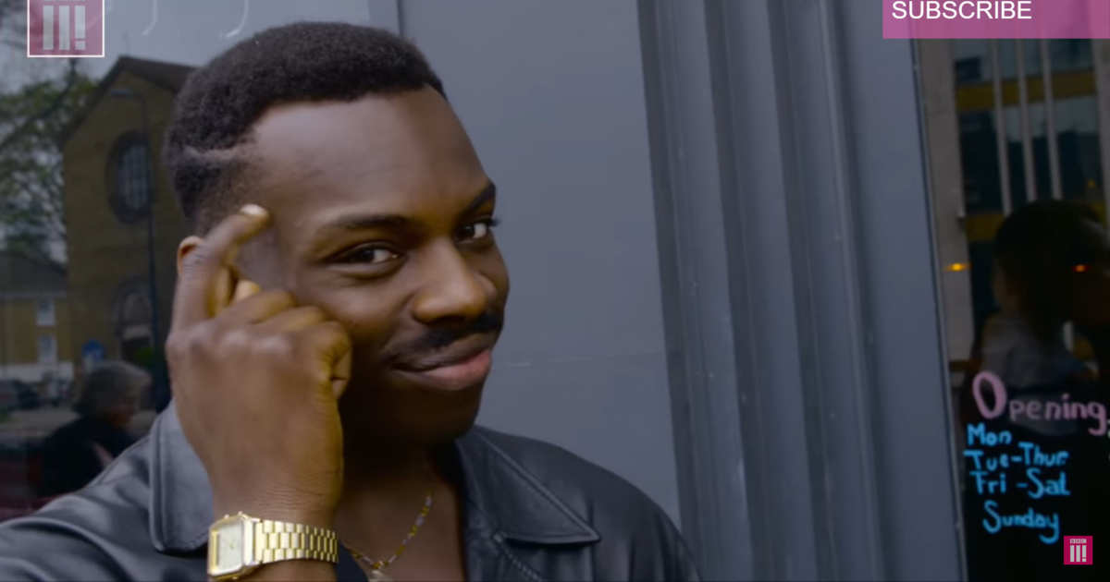
My college motto:
Study smarter, not harder.

Slide 8
Study Skills Timeline
Before
During
After
Before Class Reading the textbook Outlining material Generating questions | During Class Attention Participation Note taking | After Class Studying Memorization Test prep

Slide 9
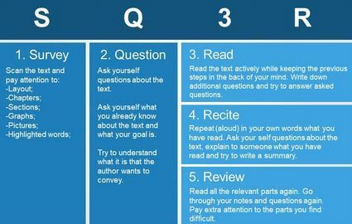
Before Class: Active Reading

Slide 10
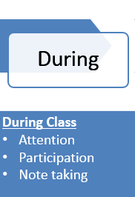
During class
Active listening:
  Set yourself up for success.
  Get the most out of your time.
  The best seat in the house (front & center).
  Eliminate distractions.
  Dare to speak.
  Take notes (cont.)

Slide 11
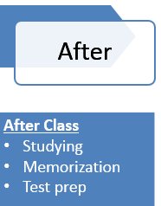
After Class
DO something with your notes.
  ASAP after class, do something with your notes.
    Elaborate
    Reorganize
    Re-write (type if you must)
    Color code
    Highlight, bold, underline
      Meaningfully, not everything

Slide 12
After Class
Studying Guidelines
  Make a study schedule.
  Studying for a test should start on the first day material is presented.
  Study in shorter periods, more often.
  Combine all your material (texts, notes, supplemental resources) into one organized study guide.
  Study the material in different orders.
  Use tricks: mnemonic devices, word associations, rhymes, songs, rehearsal and elaboration, etc.
  Anticipate what test questions a professor might ask about the material.
  Study with friends and classmates. Quiz each other.

Slide 13
My BEST advice
Avoid cramming
Time management
Organization
  Planner, calendar, to-do list, apps
Schedule your studying on a weekly basis
If you have a question, ask!
www.etsu.edu/tutoring

Slide 14
Library Resources to Support Your Research

Slide 15
Library Resources & Services
Library hours & study spaces
GetHelp button
OneSearch & databases
Subject guides & research tutorials

Slide 16
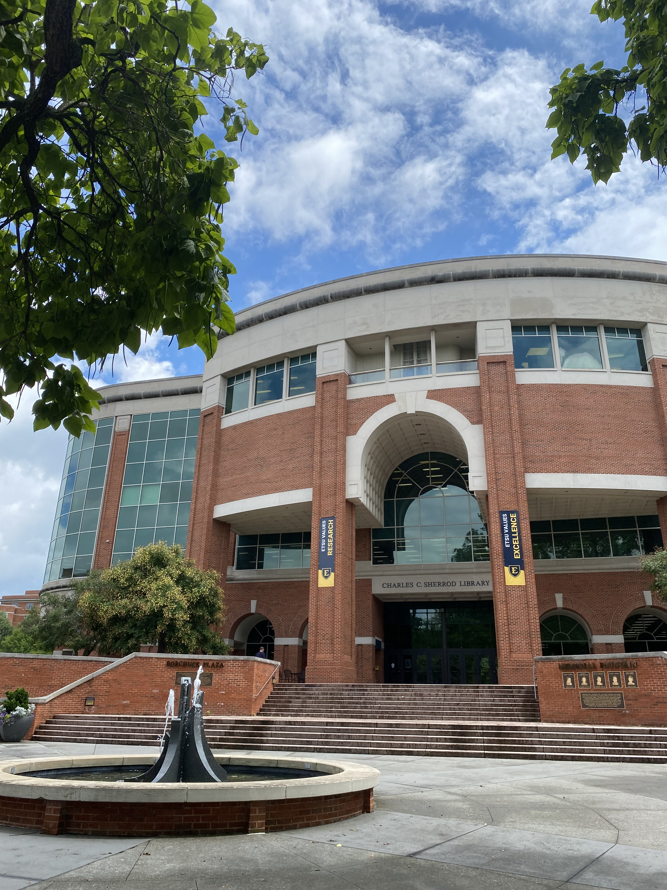
libraries.etsu.edu

