Slide 1
Wind Powered Water Pump Project
Team 1
B. Lars, D. Oran, J. Prat, M. Fiat I. Urog

Slide 2
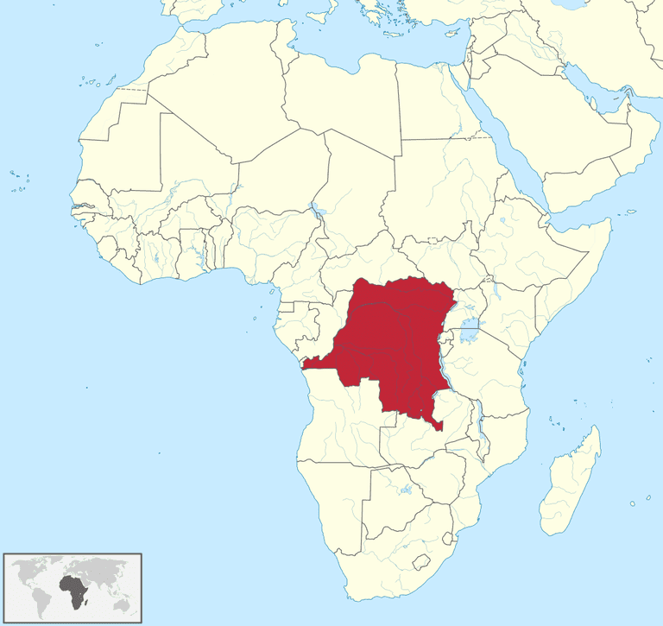

Problem Statement
OBJECTIVE: Design and engineer a simple wind powered water pump within a budget constraint for the people in need in Congo, which have a hard access to clean water.
TARGET REGION:
Democratic Republic of the Congo
Household income: $395 per year
Primary customers: end users
Secondary customers: entrepreneurs

Slide 3

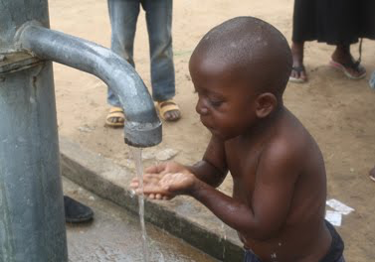
Voice of the Customer
CUSTOMER NEEDS:
Affordable (9)
Water pumped over time (9)
Quality of product (durability) (9)
Ease of use (3)
Ease of maintenance (3)
Ease to assemble (1)
Aesthetics (1)

Slide 4
Specifications and Benchmarking
COMPETITION
Johnson & Johnson
OakenHurst
Global Water Initiative
Practical Action
SPECIFICATIONS
Easy to setup and repair
It is able to power the product at 5 m/s wind speed
Product is made with durable and long-lasting materials
Tank holds 50 liters of water
Cost less than $100
Locally/Recycled stored materials are used in fabrication

Slide 5
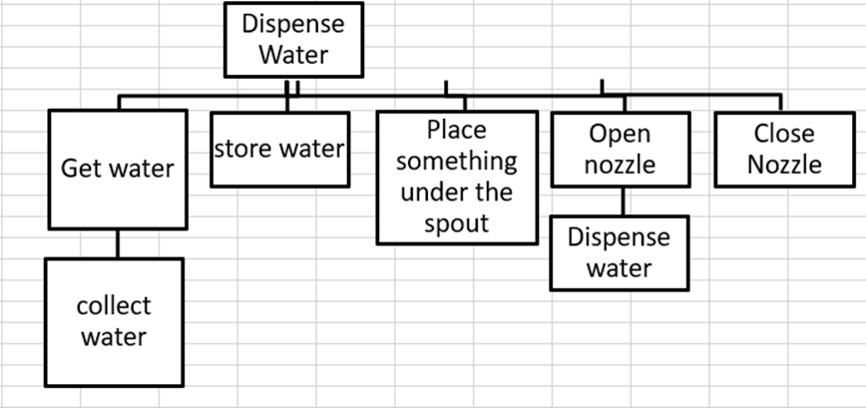
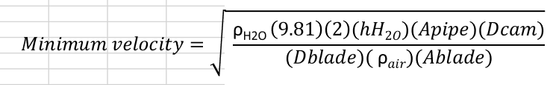
Engineering Model

Slide 6
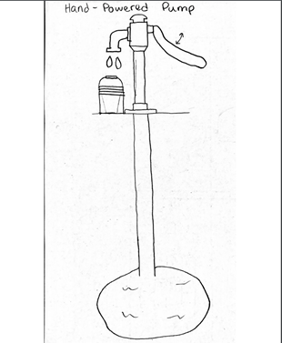
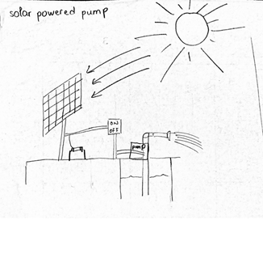
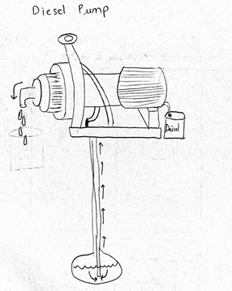
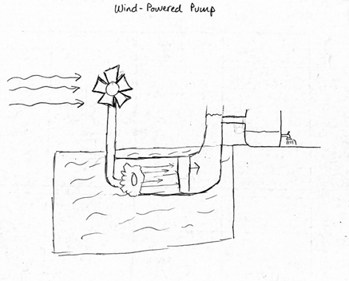
Concept Selection

Slide 7
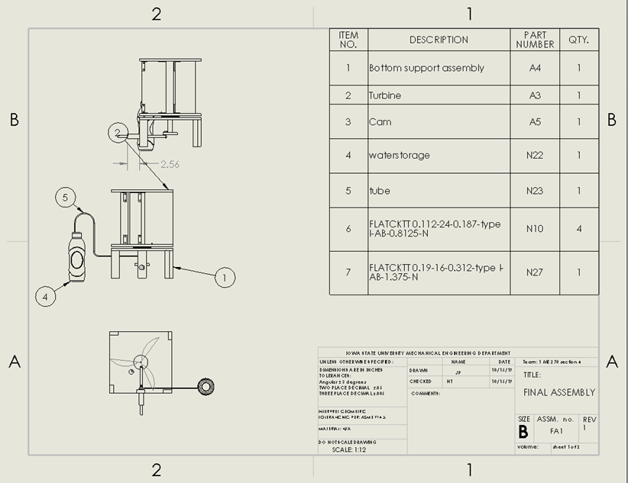
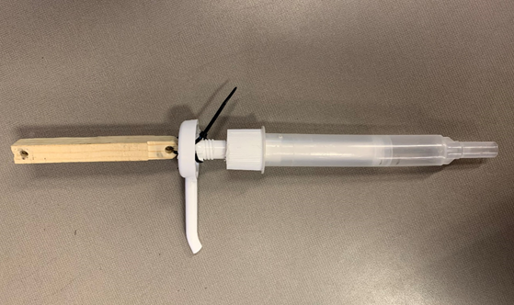
Prototype Design and Fabrication
KEY CHALLENGES IN FABRICATION:
Attaching the camshaft to the pump assembly

Slide 8
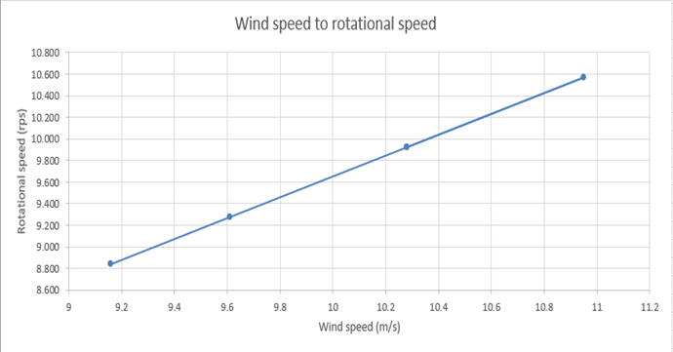
Prototype Testing
Test | Calculated result | Tested result | Conclusion
Does it pump? | It pumps | It does not pump | FAIL, pump does not work horizontally
Minimum wind speed | 2.74 m/s | 9.17 m/s | FAIL, friction and resistance were not included
Wind speed to revolutions per second | 2.64 m/s | 8.84 rps | FAIL, the results are inconsistent

Slide 9
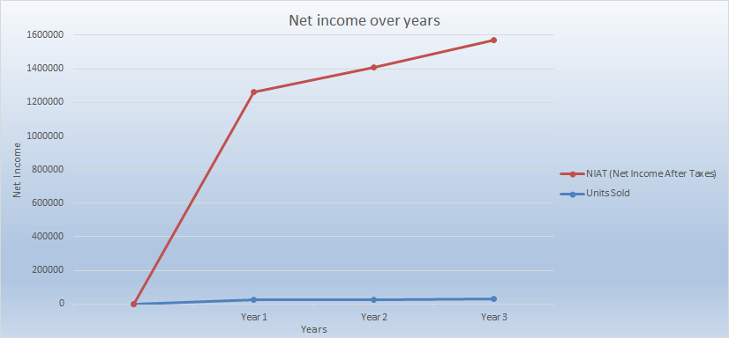

Profitability Analysis
3-year plan: 25,000 units, increasing by 10% after every year
$74 per unit, increasing $1 per year due to inflation
Market price: range between $2,000 to $15,000, depending on the quality of the product
Break even point: after 8,110 units
Each unit costs less than $70

Slide 10
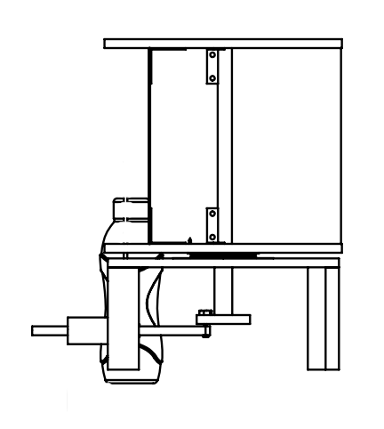
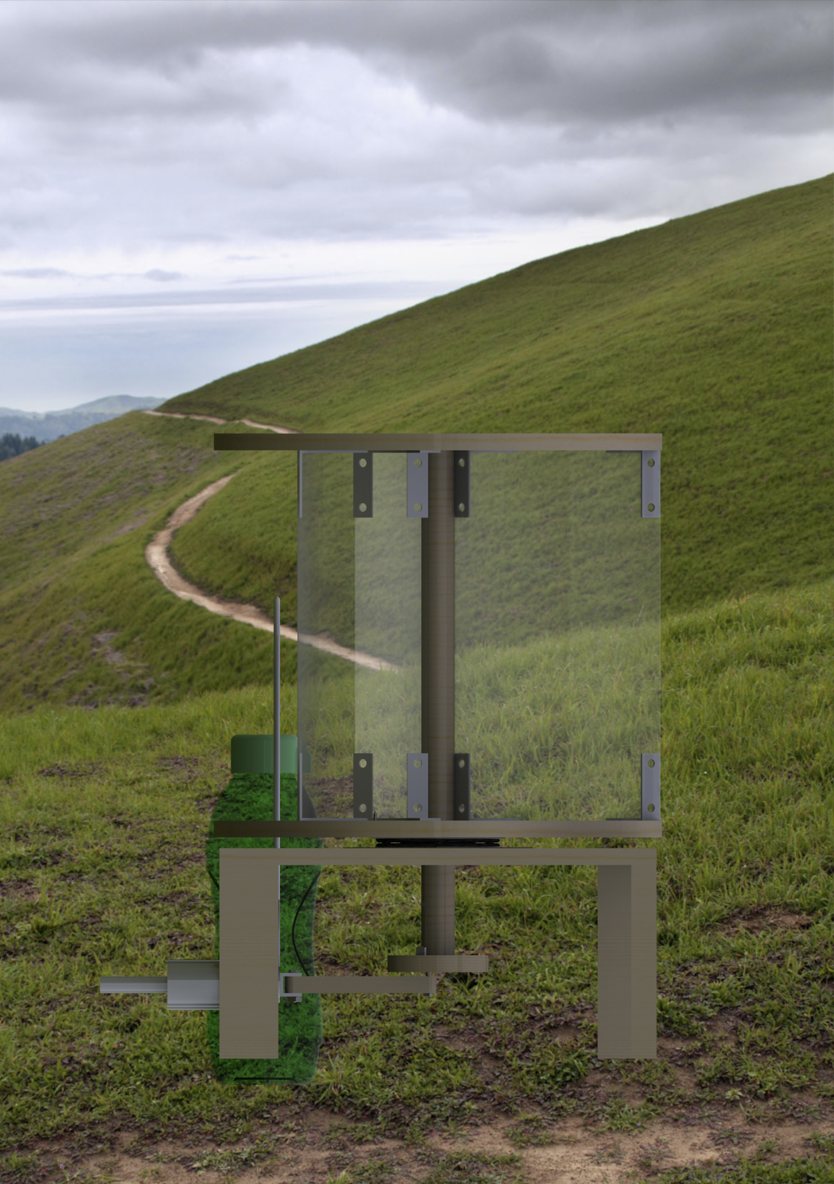
Final Design Concept
Testing revealed:
Too much friction
The pump does not work horizontally
Changes:
Washers were added between connector and cam
Did not use tubing
Made the hole on the cam closer to the middle for less range of motion

Slide 11
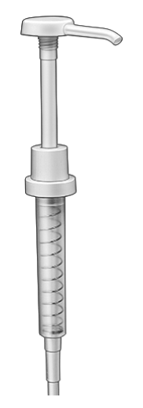
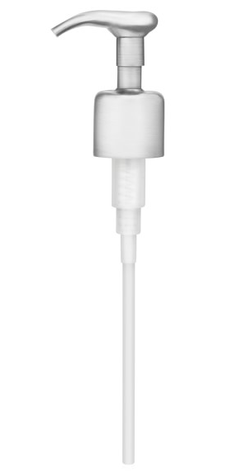
Concluding Thoughts
Challenges:
Reducing friction in the cam mechanism
Attaching the pump
File organization system
Pump selection

Slide 12


